Slide 1
GP PATIENT SURVEY 2026
The Crescent Medical Centre
PCN: Blue · Neighbourhood: Northampton Central · Registered List Size: 7,245 patients
This presentation summarises the results of the 2026 GP Patient Survey for The Crescent Medical Centre, benchmarked against national and regional comparators, and set in the context of three-year performance trends.

Slide 2
HEADLINE RESULTS
Strong Results Across All Key Measures
92 responses received (response rate 19.1%). Figures represent the percentage of patients giving a positive response in 2026.
81.2%
88.3%
87.1%
Overall Experience
Contacting the Practice
Needs Met
Above national (78.1%) and Midlands (77.4%) benchmarks
Ranked 4th in Northamptonshire
At last appointment
93.1%
93.1%
Confidence & Trust
Reception Helpful
In the clinician
Ranked 8th in Northamptonshire

Slide 3

COUNTY RANKINGS
Where We Stand Across Northamptonshire
Rankings are out of 64 practices in Northamptonshire. Rank 1 = best. Two measures place the practice in the top 10 in the county.
Measure
Result
County Rank (of 64)
Overall Experience
81.2%
22nd
Experience of Contacting the Practice
88.3%
4th ★
Needs Met at Last Appointment
87.1%
49th
Confidence & Trust in the Clinician
93.1%
26th
Reception Team Helpful
93.1%
8th ★
Two measures — access and reception — place the practice in the top 10 practices across the entire county.

Slide 4
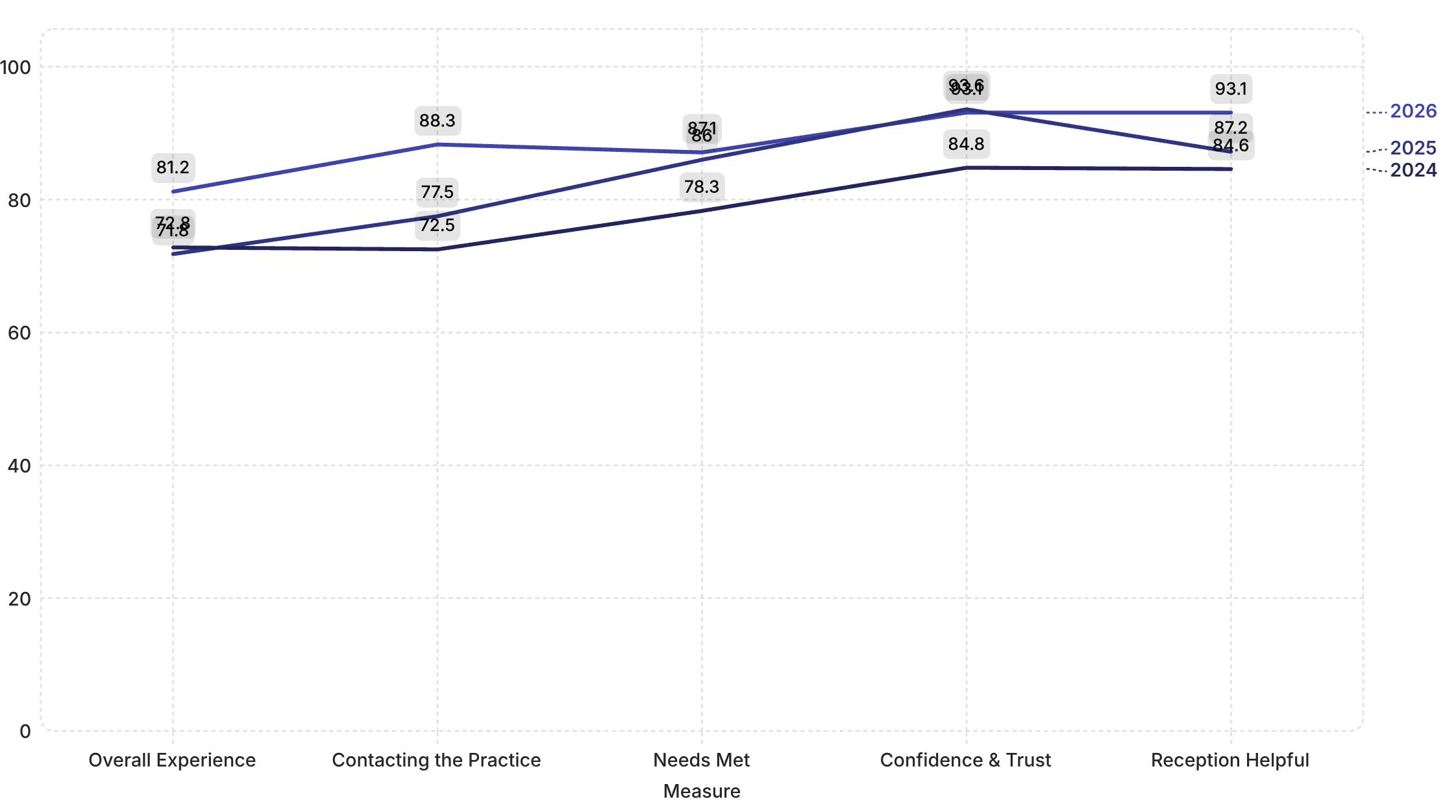
THREE-YEAR PERFORMANCE
Consistent Improvement Over Three Years
Four of five measures have improved since 2024, with particularly strong gains in overall experience and access. The chart below shows the trajectory across 2024, 2025, and 2026.
Direction of travel: Overall experience +9.4 pts · Access +10.8 pts · Needs met +1.1 pts · Confidence & trust −0.5 pts · Reception +5.9 pts (all vs 2025)

Slide 5
STATISTICAL VARIATION
Understanding Year-on-Year Changes
With 92 responses, small year-on-year movements are expected due to normal sampling variation. Each change should be read alongside its margin of error before drawing conclusions.
Measure
Change
Margin of Error
Interpretation
Overall Experience
+9.4 pts
±8.0 pts
Genuine improvement
Contacting the Practice
+10.8 pts
±6.6 pts
Genuine improvement
Needs Met at Appointment
+1.1 pts
±6.8 pts
Normal sampling variation — no clear trend
Confidence & Trust
−0.5 pts
±5.2 pts
Normal sampling variation — no real decline
Reception Team Helpful
+5.9 pts
±5.2 pts
Genuine improvement

Slide 6
STRENGTHS
Where the Practice Excels
Three areas stand out as genuine, statistically confirmed strengths — each representing a real and meaningful improvement or high baseline.
🏆 Access — Top 4 in the County
🌟 Reception Team — Top 10 in the County
📈 Overall Experience — Above Benchmarks
88.3% of patients rated their experience of contacting the practice positively — a +10.8 point improvement on 2025 and the 4th highest score in Northamptonshire. A genuine, statistically confirmed gain.
93.1% of patients found the reception team helpful — a +5.9 point improvement on 2025 and ranked 8th out of 64 practices. Staff helpfulness is a clear, sustained strength.
81.2% overall experience exceeds both the national benchmark (78.1%) and the Midlands regional benchmark (77.4%), with a +9.4 point improvement on 2025 that is larger than the margin of error.

Slide 7
SUMMARY & NEXT STEPS
Summary and Recommended Next Steps
Key Takeaways
Recommended Next Steps
Overall experience of 81.2% exceeds national and Midlands benchmarks
Access and reception are confirmed top-10 county strengths
Three measures showed genuine, statistically significant improvements in 2026
The small movements in confidence & trust (−0.5 pts) and needs met (+1.1 pts) are within normal sampling variation — no cause for concern
County rank: 22nd of 64 on overall experience
01
Share Results with the Whole Team
Celebrate the confirmed improvements in access, reception, and overall experience with all staff.
02
Investigate Needs Met (Rank 49)
Although change is within sampling variation, the county rank warrants qualitative exploration with patients and clinicians.
03
Monitor Confidence & Trust
Track this measure in 2027; the slight dip is not statistically significant but worth watching over time.

